Slide 1


Introduction to git and GitHub
For Canepi! ☺
By Sean Burnard

Slide 2
Welcome! Here is what will cover in the training session:
What is Git and GitHub
General Git workflow
Benefits of using GitHub
How to use your own Git/GitHub accounts
Downloading/ cloning repositories (‘repos’)
Website vs locally
Uploading our own repo
Locally vs website
Create and edit your own live website via GitHub!

Slide 3
Welcome! Here is what will cover in the training session:
What will you need?
Prior to the training session, you will need to have setup 4 different programmes/ accounts + 2 other ‘image related’ tasks.
What is Git and GitHub
General Git workflow
Benefits of using GitHub
How to use your own Git/GitHub accounts
Downloading/ cloning repositories (‘repos’)
Website vs locally
Uploading our own repo
Locally vs website
Create and edit your own live website via GitHub!
Text editor (programme)
Atom - https://atom.io/ (preferable over Notepad ++)
Notepad ++ https://notepad-plus-plus.org/downloads/
Git (programme)
https://git-scm.com/downloads
GitHub (account)
https://github.com/
GitHub (desktop)
https://desktop.github.com/
3 ‘personal’ photos that you are happy to share and describe!
Think of 1 cartoon or animal.
For a more detailed setup guide see the other presentation: ‘GitHub_training_intro_prior_setup_instructions.pptx’
https://github.com/SBurnard/GitHub_training

Slide 4
What is Git and GitHub
Git is version control system (works locally on your machine).
GitHub is a centralised/ ‘cloud’ hosting service for Git repositories.

Slide 5
Benefits (and examples) of Git!
Git is version control system (works locally on your machine).
GitHub is a centralised/ ‘cloud’ hosting service for Git repositories.
Git (version control) is most useful for programmers!
So probably of less interest to yourselves.

Slide 6
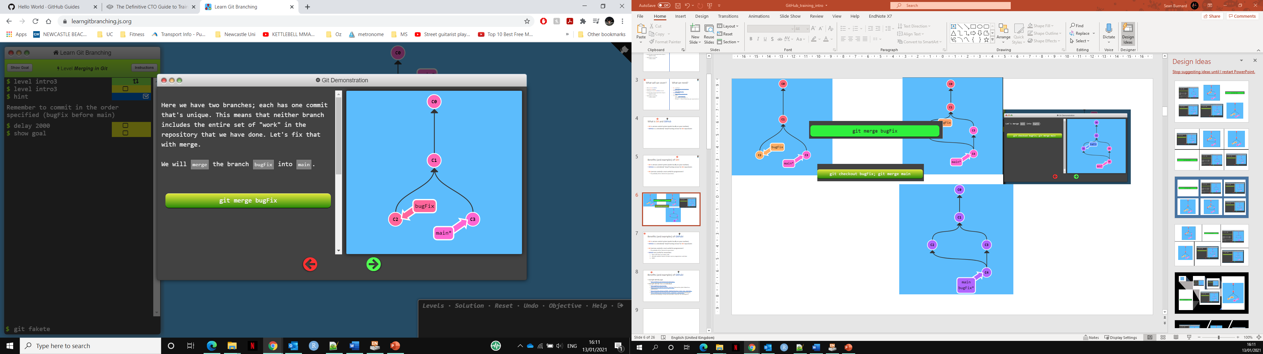
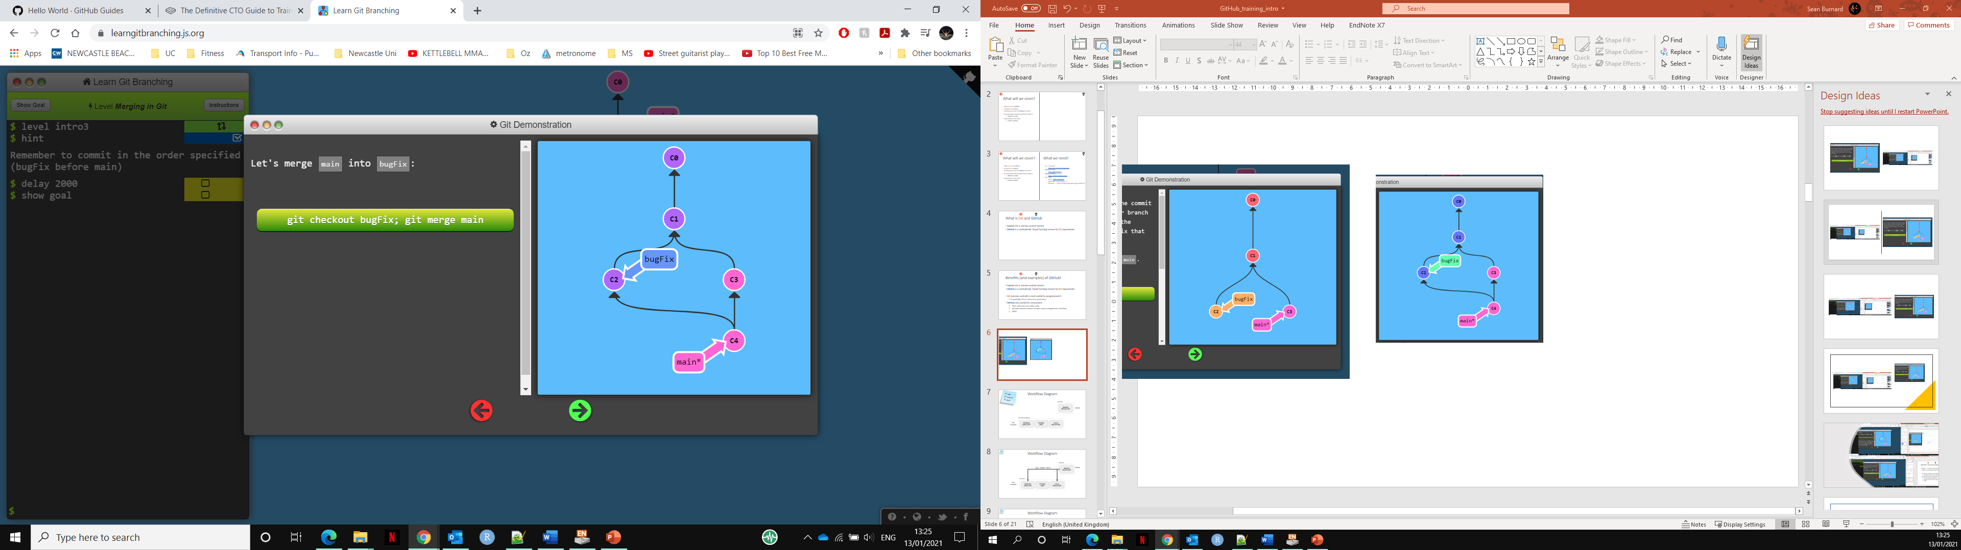
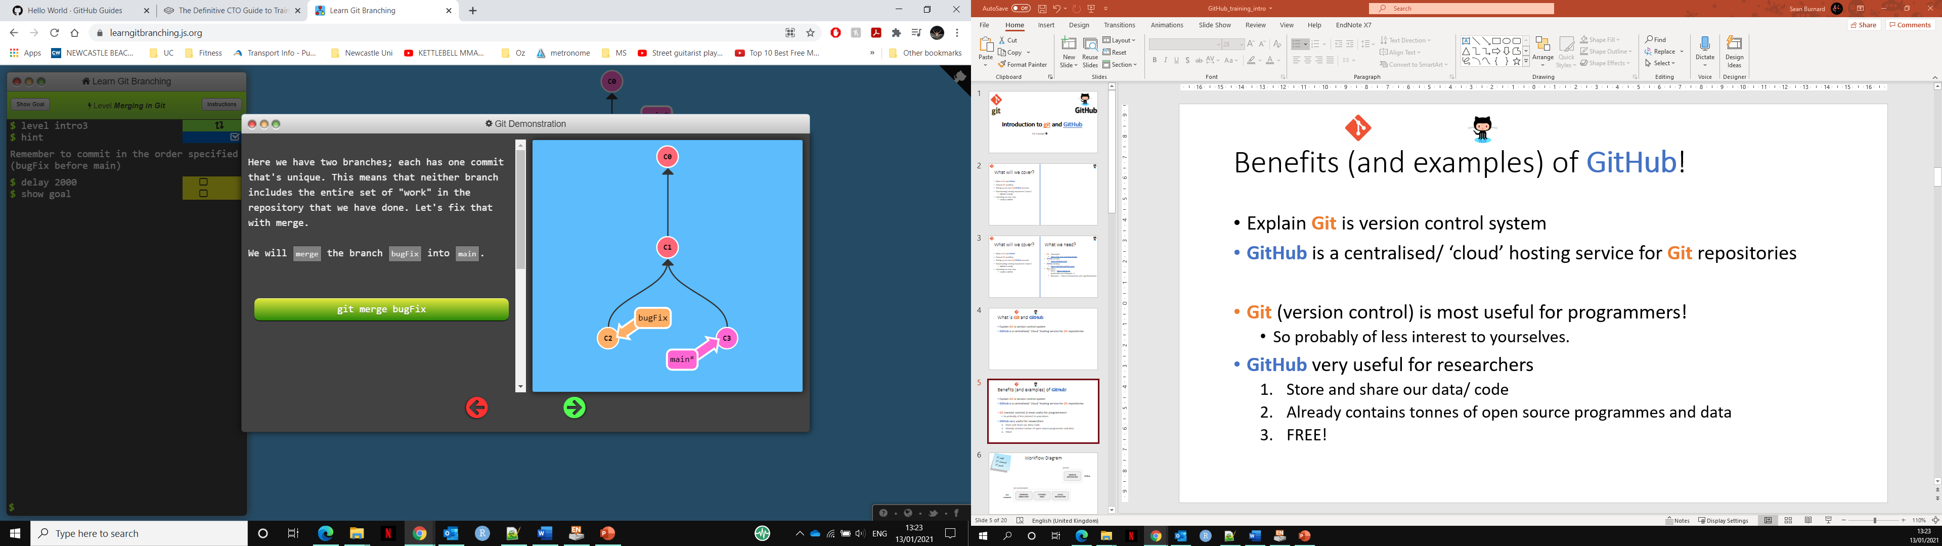
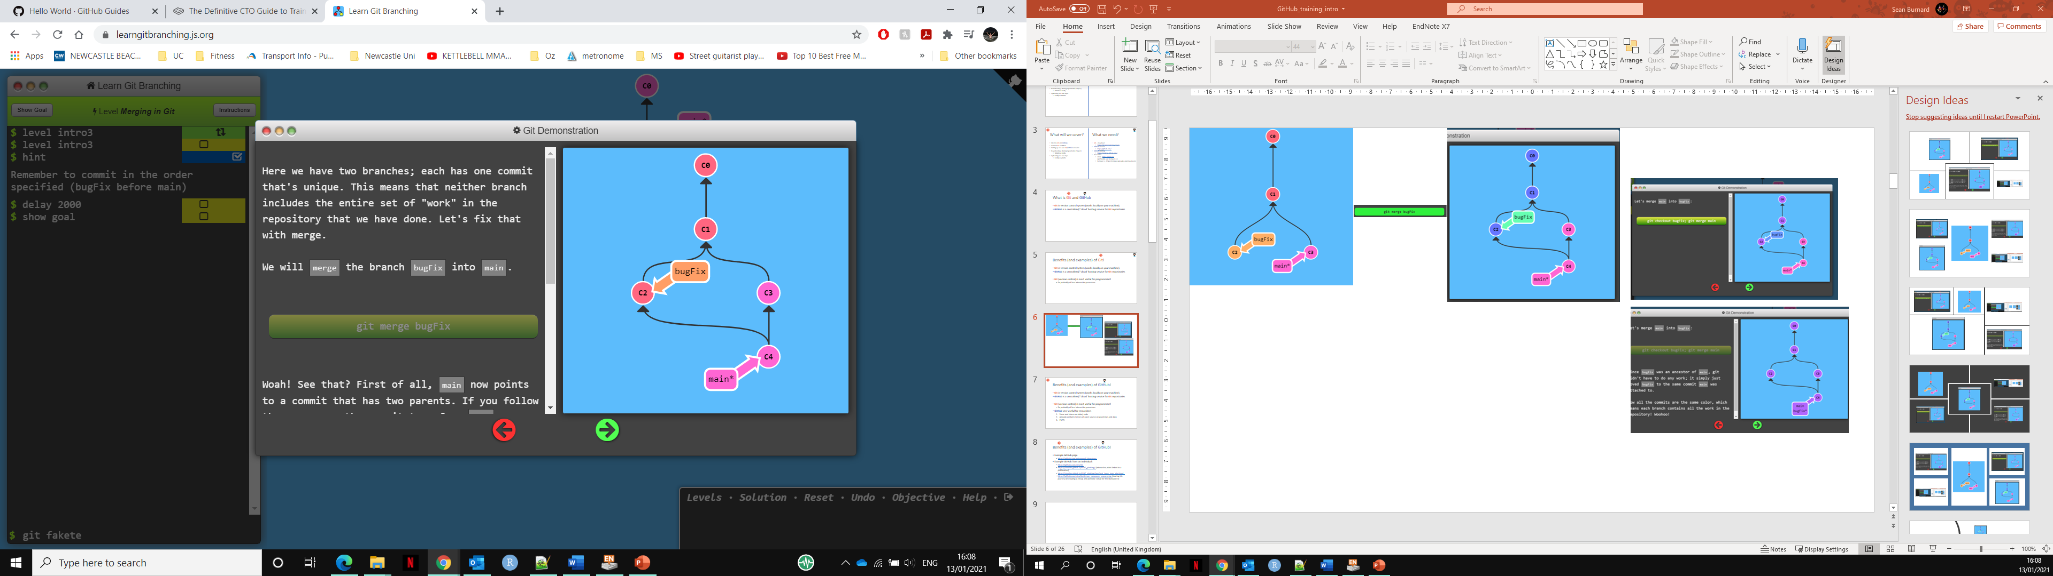
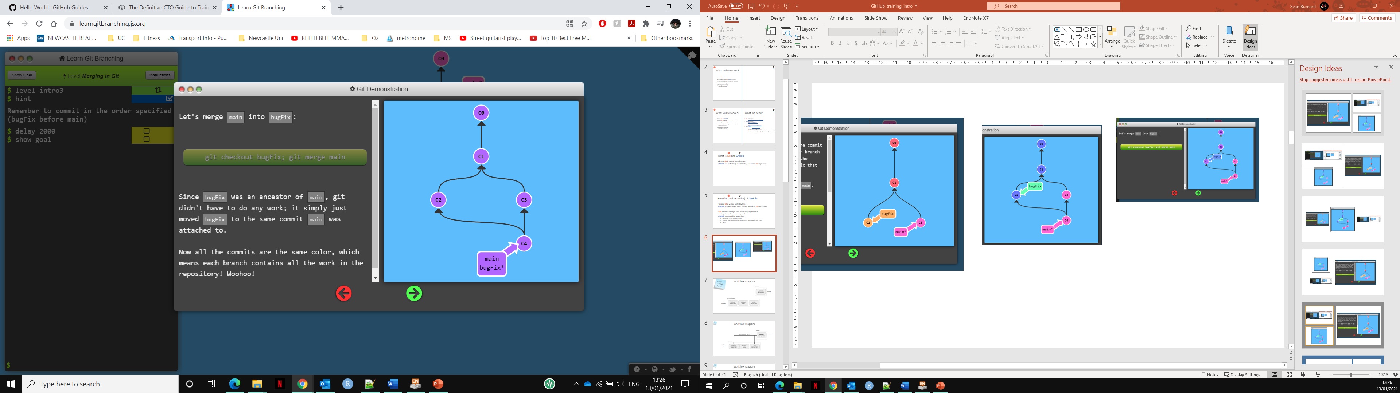
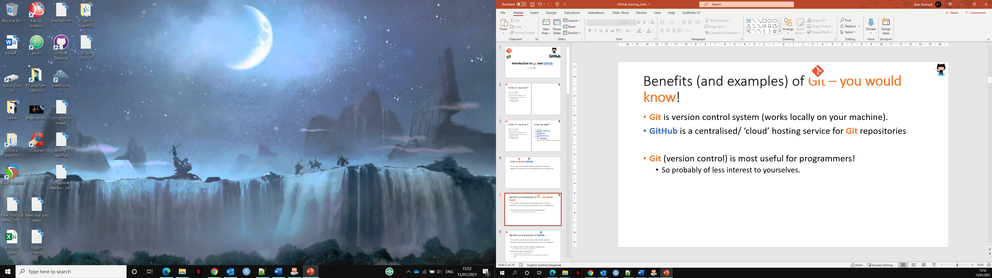
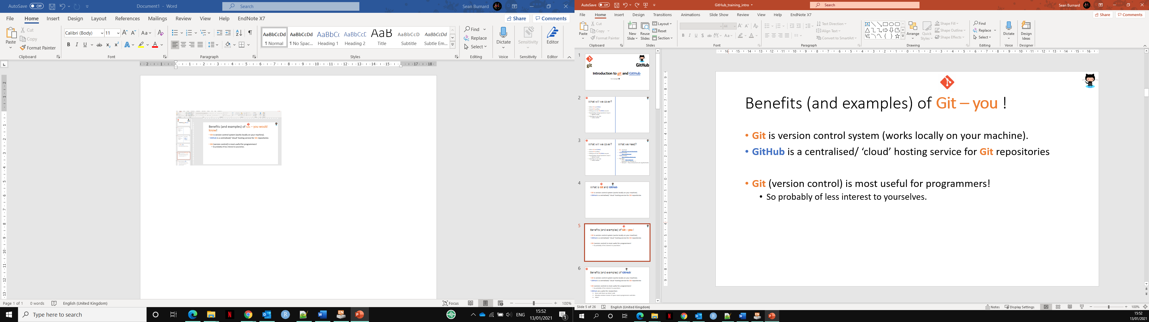
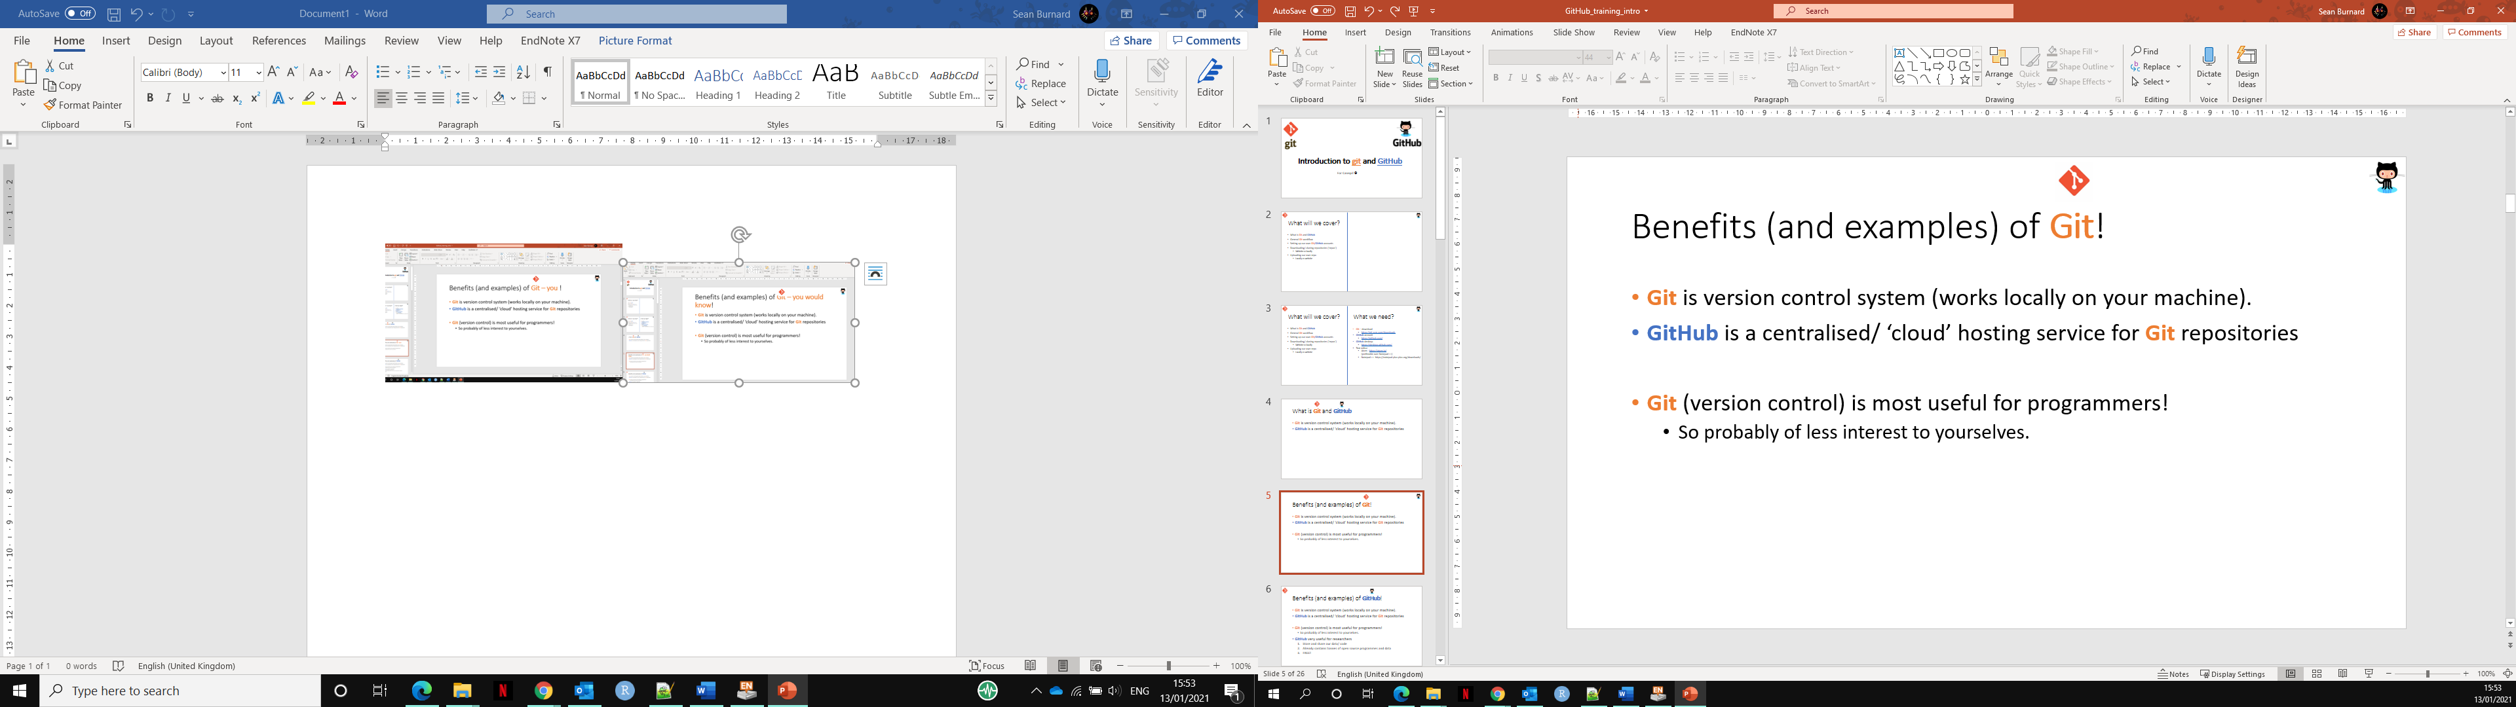
Example
Example of needing to return to an earlier version…
C3
C1
C0
Ctl z
Ctl z

Slide 7
Benefits (and examples) of GitHub!
Git is version control system (works locally on your machine).
GitHub is a centralised/ ‘cloud’ hosting service for Git repositories.
Git (version control) is most useful for programmers!
So probably of less interest to yourselves.
GitHub very useful for researchers
Store and share your data/ code
Access tonnes/ ‘heaps’ of open source programmes and data
FREE!
Versatile.

Slide 8
Benefits (and examples) of GitHub!
Example GitHub page from a lab group sharing software:
https://github.com/mhammell-laboratory
https://github.com/PMBio
Example GitHub page from an individual:
https://github.com/sirselim
Storing and sharing training:
https://github.com/PMBio/SingleCellCourse
Data and information for a publication:
https://github.com/PMBio/scNMT-seq
Easily create webpages:
https://learning-zone.github.io/website-templates/avenger-multi-purpose-responsive-html5-bootstrap-template/ (generic example template - see more https://github.com/learning-zone/website-templates )
https://sirselim.github.io/tSNE_plotting/ (Interactive plots on a webpage linked to a publication)
https://sirselim.github.io/tSNE_plotting/img/test_large_tsne_plot.html
Share your journey to promote a tool, generate interest and invite/ benefit from collaborative troubleshooting:
https://github.com/sirselim/jetson_nanopore_sequencing (his current journey developing a cheap and portable setup for the Nanopore!)
These are just a few ‘basic’ example uses of GitHub

Slide 9
How do Git + GitHub interact?

Slide 10
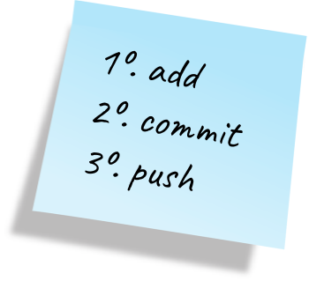
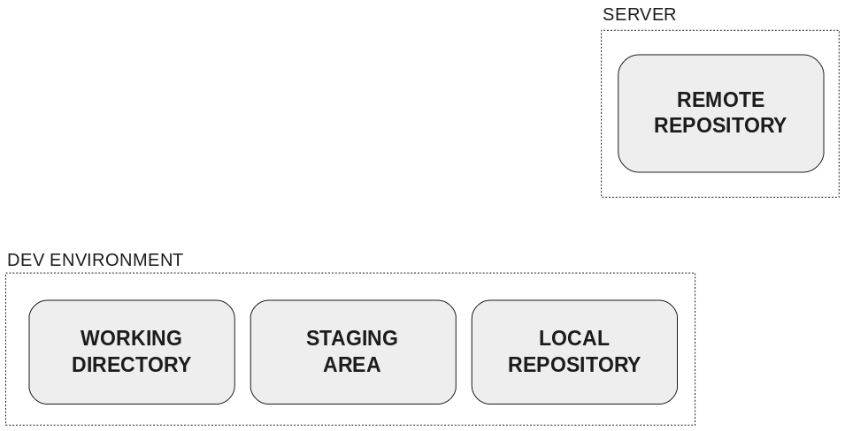
Workflow Diagram
GitHub
Our computer

Slide 11
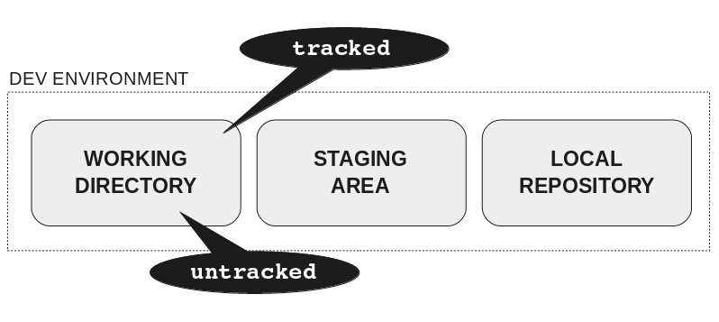
Workflow Diagram
GitHub
Our computer

Slide 12
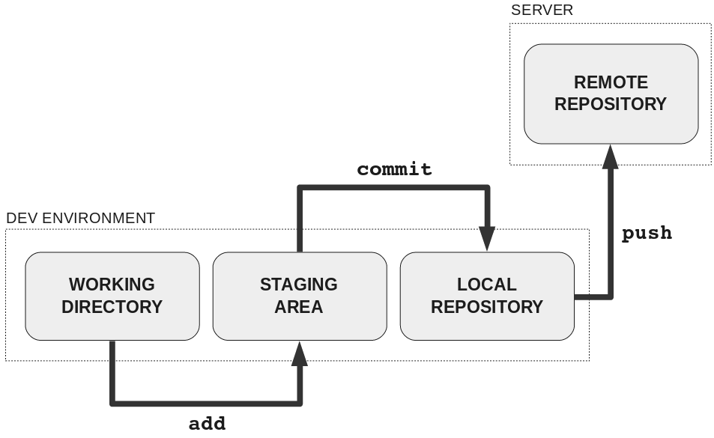
Workflow Diagram
GitHub
Our computer

Slide 13
Workflow Diagram
GitHub
Our computer

Slide 14
Workflow Diagram
GitHub
Our computer

Slide 15
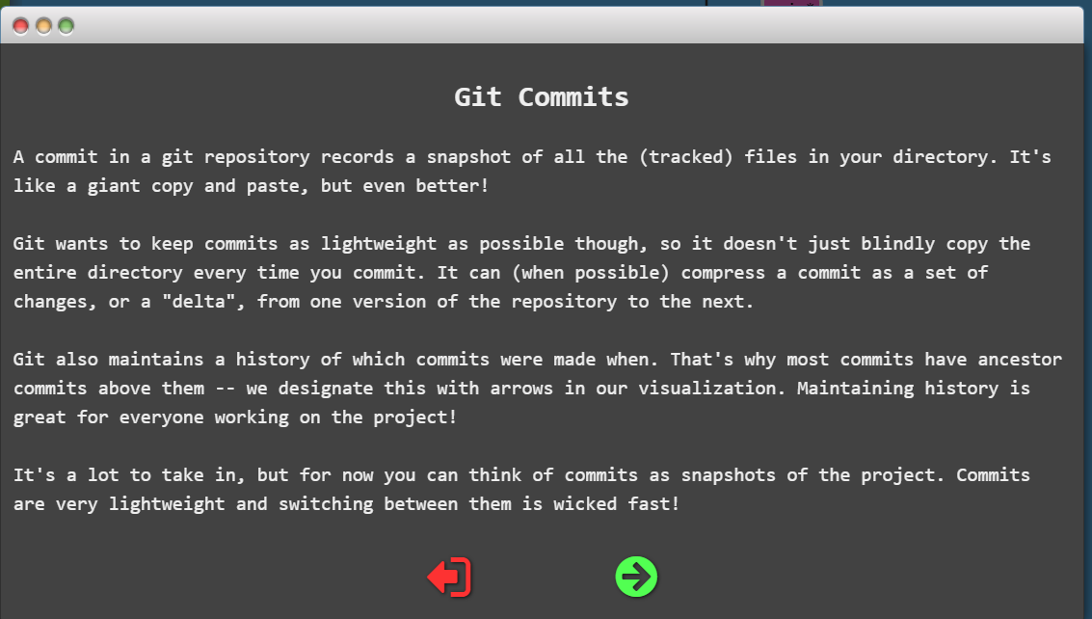
Workflow Diagram
GitHub
Our computer

Slide 16
Workflow Diagram
Local
server
GitHub
Our computer

Slide 17
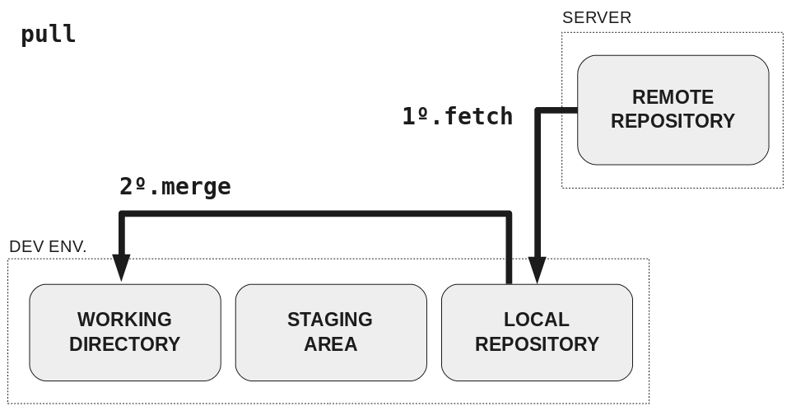
Workflow Diagram
Local
server
GitHub
Our computer

Slide 18
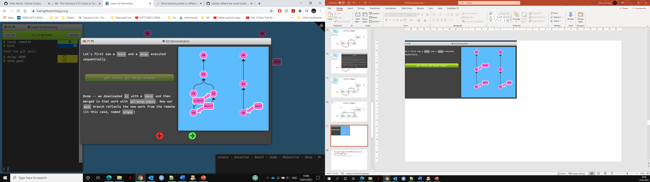
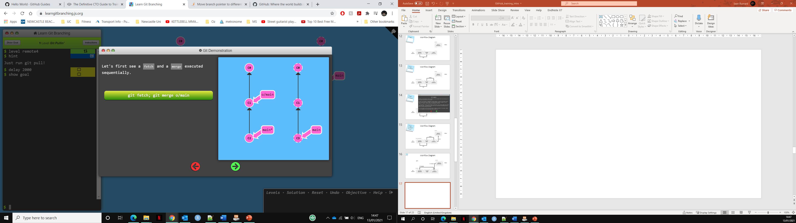
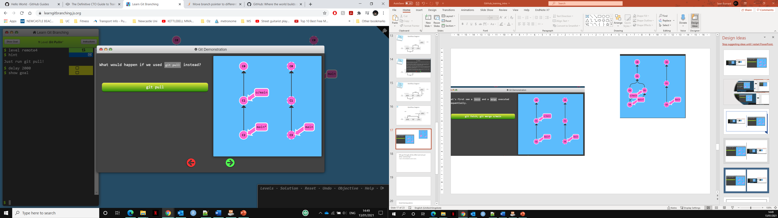
Local
server
Local
server

Slide 19
GitHub
Our computer

Slide 20
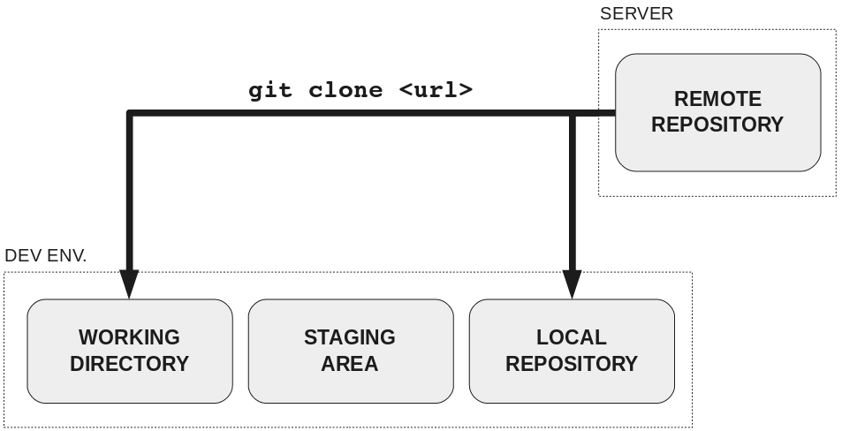
GitHub
Our computer

Slide 21

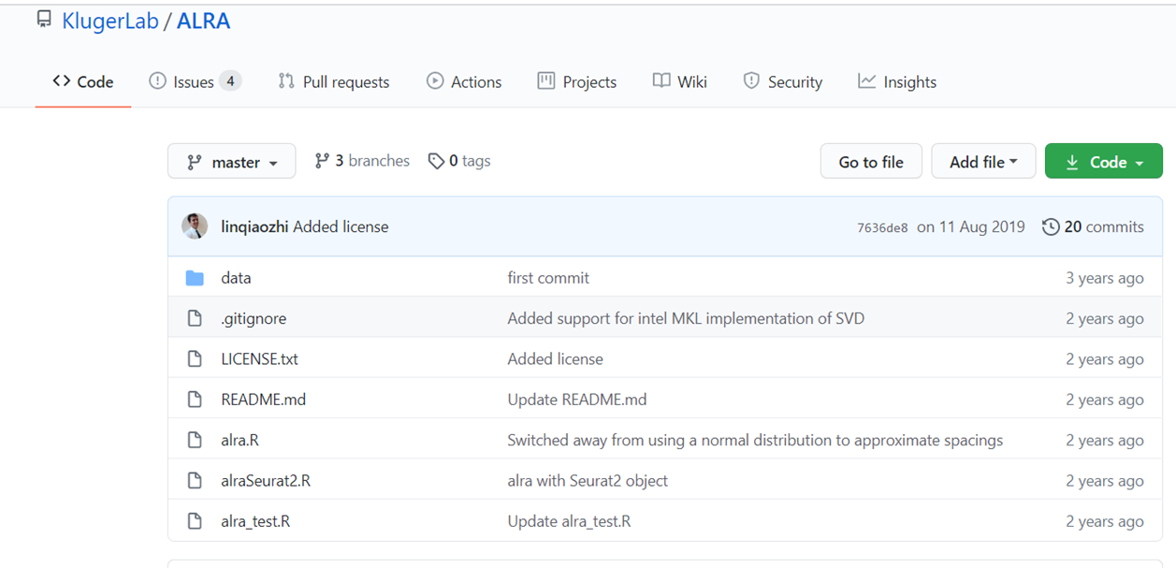
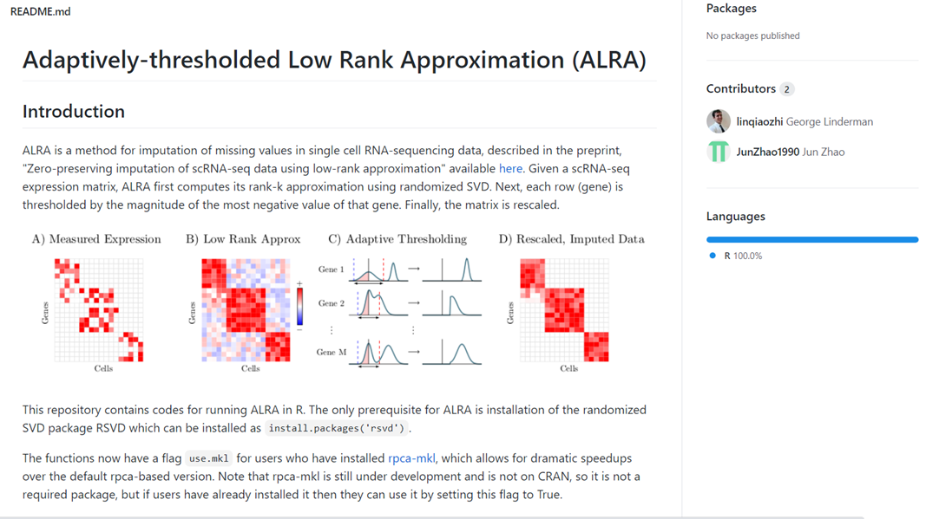
clone
local
My comp/ HPC

Slide 22
Exercises
Clone GitHub training repo
Using Git bash terminal
Open document
Make and edit your own repo
Using GitHub.com and git bash terminal
Copy contents of GitHub training.
Create a note and upload with your favourite animal.
These default as public (keep it public for this one).
Find a friend
On the GitHub website
Find each other – and find out their favourite animal… ;)
Fork and create website!
Using GitHub desktop and GitHub.com
Check your coding friends page and see if their ‘favourite animal’ featured on their webpage. :D

Slide 23
Exercise 1– ‘Clone my repo!’
Clone this GitHub training github:
https://github.com/SBurnard/GitHub_training
Open the ‘Git Bash’ programme.
Move to your desktop
cd Desktop
Clone the repo
git clone https://github.com/SBurnard/GitHub_training
DONE! You’ve now made an exact copy of all this directory and all of it’s files.
Go check it out. (And open the exercises doc)

Slide 24
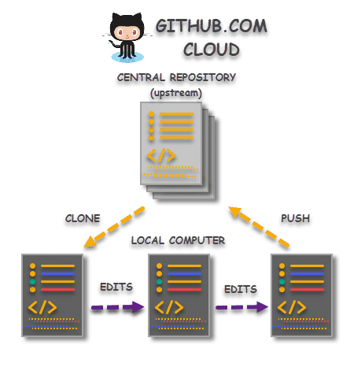
Exercise 2 – Make you own Repo A) Direct upload to GitHub and B) edit (via command line)
A
B

Slide 25
Exercise 2 – Make you own Repo
Aim:
Make you own Repo on GitHub (directly uploaded to GitHub.com)
Modify/ edit (via command line – Git Bash)
Follow the instructions in the exercises doc (from the repo you just cloned).
1
2

Slide 26
Exercise 3 – Find a friend! Collaborations require…. Collaborators! ☺
Find and follow each other. Three ‘easy’ methods:
1) use the search bar and click user.
2) type users:<name> directly in the search bar
3) Ask your friend their username and type github.com/<Their_User_Name>
And… Most importantly what was their favourite animal?! :D (Go search their public repos)

Slide 27
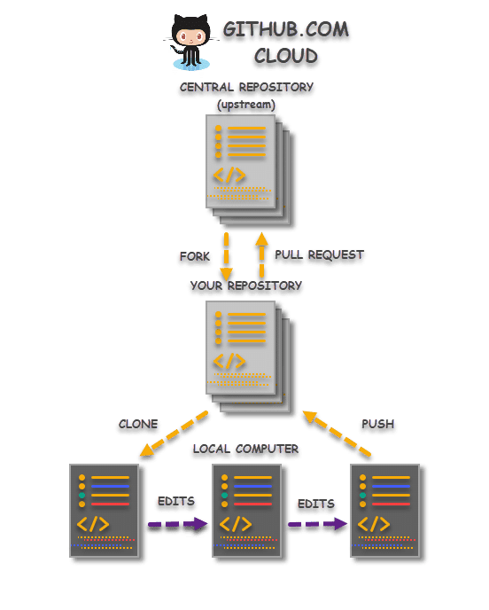
Exercise 4 – A) Fork, B) edit and C) upload your own website! (via GitHub desktop)
A)
website
C)
B)

Slide 28
Why go through all this effort and not just allow ‘autosaving’?
Such as often defaulted in word or excel….

Slide 29
Questions….
What is git?
What is GitHub?
Questions?

Slide 30
What have you learnt/ done?
Learnt and used both git and GitHub
Various benefits and uses of GitHub
Have your own GitHub account:
Created your own repo
Launched your own website!
Made some friends/ collaborators.
Used several different methods:
Git bash terminal
Git Desktop
GitHub.com (directly uploading and editing on the website)

Slide 31
Good additional training options
From GitHub:
https://lab.github.com/githubtraining/prepare-to-use-github
https://lab.github.com/githubtraining/introduction-to-github
https://lab.github.com/githubtraining/first-day-on-github
Alternative sites:
https://blog.upperlinecode.com/how-to-teach-git-commits-github-to-teenagers-a3f740b2f500
https://rachelcarmena.github.io/2018/12/12/how-to-teach-git.html
https://towardsdatascience.com/getting-started-with-git-and-github-6fcd0f2d4ac6
https://learngitbranching.js.org/ (interactive for git)

